Slide 1
OOP PROJECT
ROAD PROFILING

Slide 2
OBJECTIVE
BASED UPON THE DATA INPUTS LIKE GPS AND ACCELEROMETER DATA, CLASSIFY THE ROADS ON THE BASIS OF SMOOTH ROAD, BUMPER AND POTHOLES.

Slide 3
The outline of the project
First Kalman filter is needed to normalize the input data.
Next linear regression is used to predict the data for unknown devices.
Final step is to identify the potholes and bumpers of the road analyzing the data.
Use linear regression to predict for different devices
Use Kalman filter to make the input data noise free
Predict the smoothness or pothole or bumpers of the road
Goal

Slide 4
KALMAN FILTER
The Kalman filter is an efficient recursive filter that estimates the normalized from a series of noisy measurements.
The Kalman filter calculates estimates of the true values of states recursively over time using incoming measurements and a mathematical process model.
In this project the Kalman filter is used to rectify the noise and create a stable set of input data which can be handled with less probability of error.

Slide 5
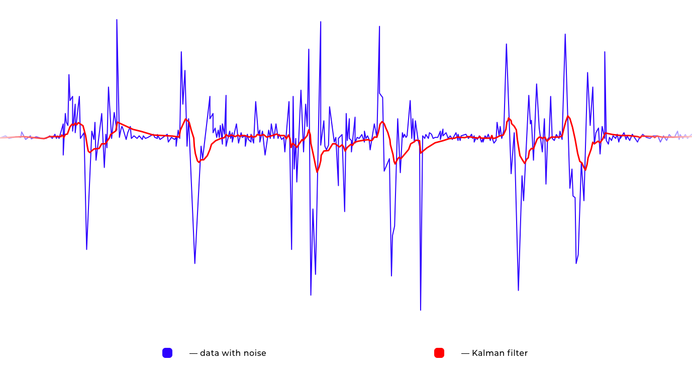
KALMAN FILTER
This pictures shows the effectiveness of Kalman filter to rectify the noise of the input data. After using the Kalman filter the data is normalised and more suitable for the project.

Slide 6
LINEAR REGRESSION
Simple linear regression concerns two-dimensional sample points with one independent variable and one dependent variable and finds a linear function that, as accurately as possible, predicts the dependent variable values as a function of the independent variables.
In this project the linear regression is used to predict the data from unknown devices.

Slide 7
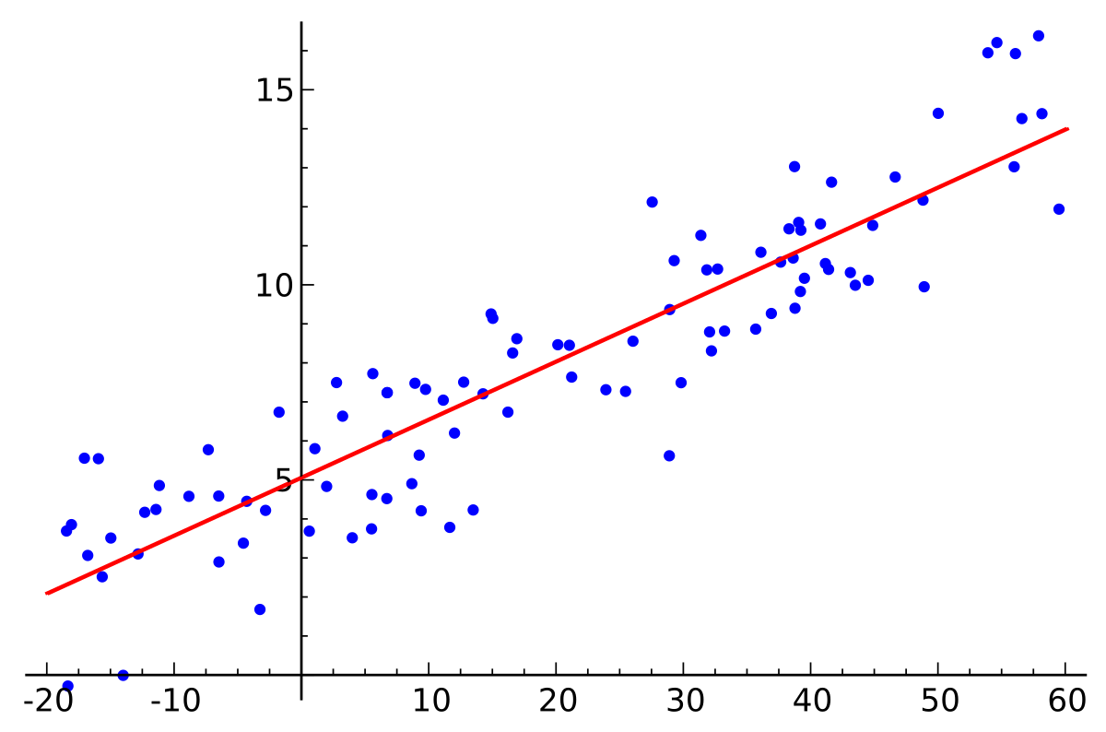
Single Variable Linear Regression
The value of X axis remains constant while there the various type of value on Y axis. Linear Regression predicts the most accurate value. The function is represented by the straight line.

Slide 8
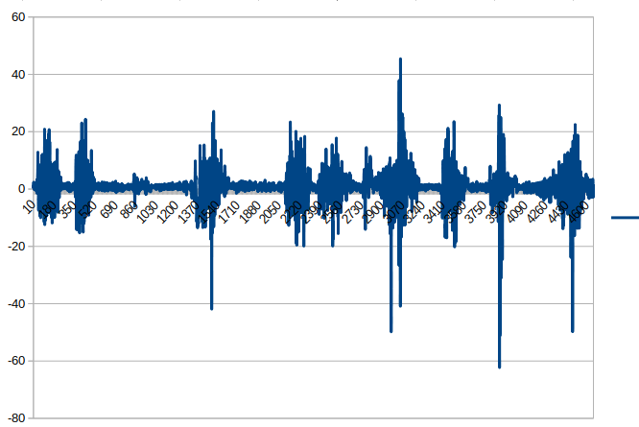
VARIATION OF RMS VALUES WITH INDEX

Slide 9
PREDICTION OF THE ROADS
If the value of Z is less than 5 or greater than -5, then the road is termed as smooth road. The change of Z is mainly due to vibration of the car.
If the value of Z is greater than 5 but less than 14, that portion of Road is termed as pothole.
If the value of Z is greater then 14 then there exists some bumper.
In any other cases there exists the potholes.

Slide 10
MEMBERS OF THE PROJECT
Abhijit Roy
Abhishek Kumar
Arpan Saha
Ayanava Paul
Bikrant Kumar Singh
Kaif Mukhtar
Khushi Luharuwalla(LEADER)
Nafisa Ahmed
Samrat De
Shreya Roy
Suraj Kumar Modi

Slide 11
THANK YOU

